Slide 1
W4111 – Introduction to Databases Module II (4), NoSQL (4)
© Donald F. Ferguson, 2025

Slide 2

Contents
2 | W4111-2025S-11-Module-II-NoSql-Module-IV-1 © Donald F. Ferguson, 2025

Slide 3
Contents
Transactions – some advanced concepts
Locking
Deadlock
Schedules and consistency models
ACID, BASE, Eventual Consistency, “CAP Theorem”
Big Data
Introduction to concepts: Data lake, data warehouse, ETL/ELT
Star schema
Project and HW 5
Overview
Full stack web application, REST overview
Code orientation and walkthroughs

Slide 4
Contents
4 | W4111-2025S-11-Module-II-NoSql-Module-IV-1 © Donald F. Ferguson, 2025

Slide 5

Locking
Deadlock

Slide 6
Lock-Based Protocols
A lock is a mechanism to control concurrent access to a data item
Data items can be locked in two modes :
1. exclusive (X) mode. Data item can be both read as well as
written. X-lock is requested using lock-X instruction.
2. shared (S) mode. Data item can only be read. S-lock is
requested using lock-S instruction.
Lock requests are made to concurrency-control manager. Transaction can proceed only after request is granted.

Slide 7
Lock-Based Protocols (Cont.)
Lock-compatibility matrix
A transaction may be granted a lock on an item if the requested lock is compatible with locks already held on the item by other transactions
Any number of transactions can hold shared locks on an item,
But if any transaction holds an exclusive on the item no other transaction may hold any lock on the item.
Notes:
If a lock cannot be granted, the requesting transaction is made to wait till all incompatible locks held by other transactions have been released. The lock is then granted.

Slide 8
Lock-Based Protocols (Cont.)
Example of a transaction performing locking:
T₂: lock-S(A);
read (A);
unlock(A);
lock-S(B);
read (B);
unlock(B);
display(A+B)
Locking as above is not sufficient to guarantee serializability
Based on something I said in the last lecture, anyone know why?

Slide 9
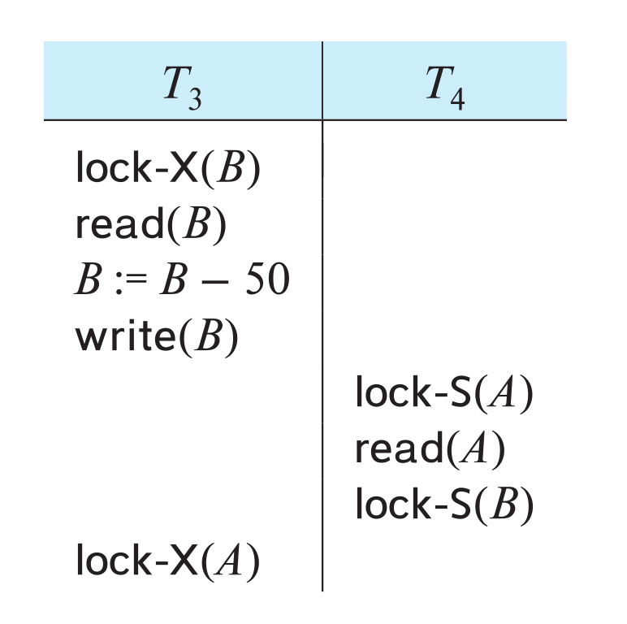
Deadlock
Consider the partial schedule
Neither T₃ nor T₄ can make progress — executing lock-S(B) causes T₄ to wait for T₃ to release its lock on B, while executing lock-X(A) causes T₃ to wait for T₄ to release its lock on A.
Such a situation is called a deadlock.
To handle a deadlock one of T₃ or T₄ must be rolled back and its locks released.

Slide 10
Deadlock (Cont.)
The potential for deadlock exists in most locking protocols. Deadlocks are a necessary evil.
Starvation is also possible if concurrency control manager is badly designed. For example:
A transaction may be waiting for an X-lock on an item, while a sequence of other transactions request and are granted an S-lock on the same item.
The same transaction is repeatedly rolled back due to deadlocks.
Concurrency control manager can be designed to prevent starvation.

Slide 11
The Two-Phase Locking Protocol
A protocol which ensures conflict-serializable schedules.
Phase 1: Growing Phase
Transaction may obtain locks
Transaction may not release locks
Phase 2: Shrinking Phase
Transaction may release locks
Transaction may not obtain locks
The protocol assures serializability. It can be proved that the transactions can be serialized in the order of their lock points (i.e., the point where a transaction acquired its final lock).
Locks
Time

Slide 12
The Two-Phase Locking Protocol (Cont.)
Two-phase locking does not ensure freedom from deadlocks
Extensions to basic two-phase locking needed to ensure recoverability of freedom from cascading roll-back
Strict two-phase locking: a transaction must hold all its exclusive locks till it commits/aborts.
Ensures recoverability and avoids cascading roll-backs
Rigorous two-phase locking: a transaction must hold all locks till commit/abort.
Transactions can be serialized in the order in which they commit.
Most databases implement rigorous two-phase locking, but refer to it as simply two-phase locking

Slide 13
Implementation of Locking
A lock manager can be implemented as a separate process
Transactions can send lock and unlock requests as messages
The lock manager replies to a lock request by sending a lock grant messages (or a message asking the transaction to roll back, in case of a deadlock)
The requesting transaction waits until its request is answered
The lock manager maintains an in-memory data-structure called a lock table to record granted locks and pending requests

Slide 14
Deadlock Handling
System is deadlocked if there is a set of transactions such that every transaction in the set is waiting for another transaction in the set.

Slide 15
Deadlock Handling
Deadlock prevention protocols ensure that the system will never enter into a deadlock state. Some prevention strategies:
Require that each transaction locks all its data items before it begins execution (pre-declaration).
Impose partial ordering of all data items and require that a transaction can lock data items only in the order specified by the partial order (graph-based protocol).

Slide 16
More Deadlock Prevention Strategies
wait-die scheme — non-preemptive
Older transaction may wait for younger one to release data item.
Younger transactions never wait for older ones; they are rolled back instead.
A transaction may die several times before acquiring a lock
wound-wait scheme — preemptive
Older transaction wounds (forces rollback) of younger transaction instead of waiting for it.
Younger transactions may wait for older ones.
Fewer rollbacks than wait-die scheme.
In both schemes, a rolled back transactions is restarted with its original timestamp.
Ensures that older transactions have precedence over newer ones, and starvation is thus avoided.

Slide 17
Deadlock prevention (Cont.)
Timeout-Based Schemes:
A transaction waits for a lock only for a specified amount of time. After that, the wait times out and the transaction is rolled back.
Ensures that deadlocks get resolved by timeout if they occur
Simple to implement
But may roll back transaction unnecessarily in absence of deadlock
Difficult to determine good value of the timeout interval.
Starvation is also possible

Slide 18
Deadlock Detection
Wait-for graph
Vertices: transactions
Edge from T_{i} →T_{j}. : if T_{i} is waiting for a lock held in conflicting mode byT_{j}
The system is in a deadlock state if and only if the wait-for graph has a cycle.
Invoke a deadlock-detection algorithm periodically to look for cycles.
Wait-for graph without a cycle
Wait-for graph with a cycle

Slide 19
Schedules Consistency/Serializability Models

Slide 20
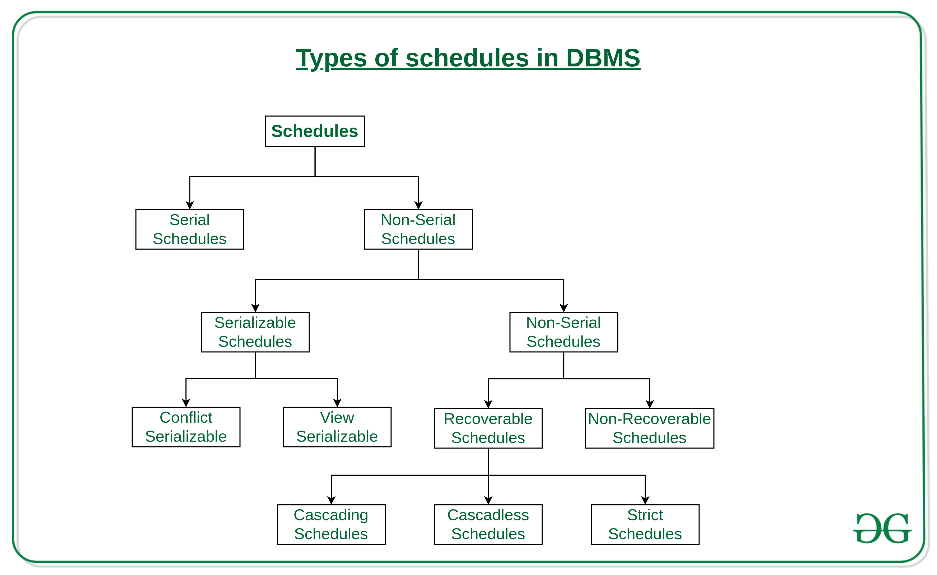
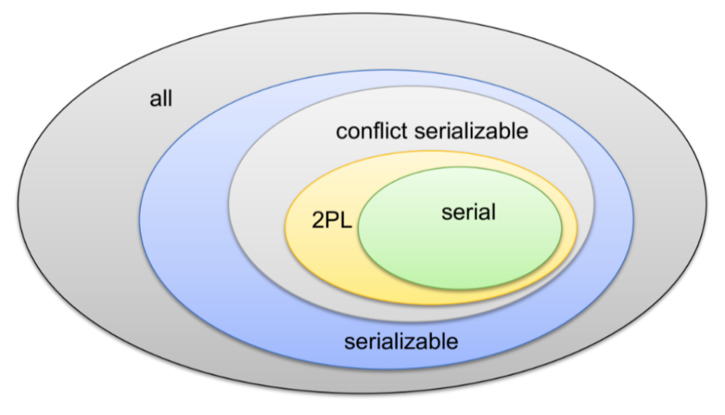
Schedules and Serializable
We covered serial schedules, 2PL and serializable in the previous lecture.
The types of schedules are much more complex.
There are also forms of conflict management and lock types other than R/W.
We will talk a little bit about them for awareness.
These are academically interesting but do not come up in practice.

Slide 21
Serializability
Basic Assumption – Each transaction preserves database consistency.
Thus, serial execution of a set of transactions preserves database consistency.
A (possibly concurrent) schedule is serializable if it is equivalent to a serial schedule. Different forms of schedule equivalence give rise to the notions of:
1. Conflict serializability
2. View serializability

Slide 22
Simplified view of transactions
We ignore operations other than read and write instructions
We assume that transactions may perform arbitrary computations on data in local buffers in between reads and writes.
Our simplified schedules consist of only read and write instructions.

Slide 23
Conflicting Instructions
Instructions l_{i} and l_{j} of transactions T_{i} and T_{j} respectively, conflict if and only if there exists some item Q accessed by both l_{i} and l_{j}, and at least one of these instructions wrote Q.
1. l_{i} = read(Q), l_{j} = read(Q). l_{i} and l_{j} don’t conflict. 2. l_{i} = read(Q), l_{j} = write(Q). They conflict. 3. l_{i} = write(Q), l_{j} = read(Q). They conflict 4. l_{i} = write(Q), l_{j} = write(Q). They conflict
Intuitively, a conflict between l_{i} and l_{j} forces a (logical) temporal order between them.
If l_{i} and l_{j} are consecutive in a schedule and they do not conflict, their results would remain the same even if they had been interchanged in the schedule.

Slide 24
Conflict Serializability
If a schedule S can be transformed into a schedule S’ by a series of swaps of non-conflicting instructions, we say that S and S’ are conflict equivalent.
We say that a schedule S is conflict serializable if it is conflict equivalent to a serial schedule

Slide 25
Conflict Serializability (Cont.)
Schedule 3 can be transformed into Schedule 6, a serial schedule where T₂ follows T₁, by series of swaps of non-conflicting instructions. Therefore Schedule 3 is conflict serializable.
Schedule 3
Schedule 6

Slide 26
Conflict Serializability (Cont.)
Example of a schedule that is not conflict serializable:
We are unable to swap instructions in the above schedule to obtain either the serial schedule < T₃, T₄ >, or the serial schedule < T₄, T₃ >.

Slide 27
View Serializability
Let S and S’ be two schedules with the same set of transactions. S and S’ are view equivalent if the following three conditions are met, for each data item Q,
1. If in schedule S, transaction T_{i} reads the initial value of Q, then in
schedule S’ also transaction T_{i} must read the initial value of Q.
2. If in schedule S transaction T_{i} executes read(Q), and that value was
produced by transaction T_{j} (if any), then in schedule S’ also
transaction T_{i} must read the value of Q that was produced by the
same write(Q) operation of transaction T_{j} .
3. The transaction (if any) that performs the final write(Q) operation in
schedule S must also perform the final write(Q) operation in schedule S’.
As can be seen, view equivalence is also based purely on reads and writes alone.

Slide 28
View Serializability (Cont.)
A schedule S is view serializable if it is view equivalent to a serial schedule.
Every conflict serializable schedule is also view serializable.
Below is a schedule which is view-serializable but not conflict serializable.
What serial schedule is above equivalent to?
Every view serializable schedule that is not conflict serializable has blind writes.

Slide 29
Testing for Serializability
Consider some schedule of a set of transactions T₁, T₂, ..., T_{n}
Precedence graph — a direct graph where the vertices are the transactions (names).
We draw an arc from T_{i} to T_{j} if the two transaction conflict, and T_{i} accessed the data item on which the conflict arose earlier.
We may label the arc by the item that was accessed.
Example of a precedence graph

Slide 30
Test for Conflict Serializability
A schedule is conflict serializable if and only if its precedence graph is acyclic.
Cycle-detection algorithms exist which take order n² time, where n is the number of vertices in the graph.
(Better algorithms take order n + e where e is the number of edges.)
If precedence graph is acyclic, the serializability order can be obtained by a topological sorting of the graph.
This is a linear order consistent with the partial order of the graph.
For example, a serializability order for Schedule A would be T₅ → T₁ → T₃ → T₂ → T₄
Are there others?

Slide 31
Recoverable Schedules
Need to address the effect of transaction failures on concurrently running transactions.
Recoverable schedule — if a transaction T_{j} reads a data item previously written by a transaction T_{i} , then the commit operation of T_{i} appears before the commit operation of T_{j}.
The following schedule (Schedule 11) is not recoverable
If T₈ should abort, T₉ would have read (and possibly shown to the user) an inconsistent database state. Hence, database must ensure that schedules are recoverable.

Slide 32
Cascading Rollbacks
Cascading rollback – a single transaction failure leads to a series of transaction rollbacks. Consider the following schedule where none of the transactions has yet committed (so the schedule is recoverable) If T₁₀ fails, T₁₁ and T₁₂ must also be rolled back.
Can lead to the undoing of a significant amount of work

Slide 33
Weak Levels of Consistency
Some applications are willing to live with weak levels of consistency, allowing schedules that are not serializable
E.g., a read-only transaction that wants to get an approximate total balance of all accounts
E.g., database statistics computed for query optimization can be approximate (why?)
Such transactions need not be serializable with respect to other transactions
Tradeoff accuracy for performance

Slide 34
Levels of Consistency in SQL-92
Serializable — default
Repeatable read — only committed records to be read.
Repeated reads of same record must return same value.
However, a transaction may not be serializable – it may find some records inserted by a transaction but not find others.
Read committed — only committed records can be read.
Successive reads of record may return different (but committed) values.
Read uncommitted — even uncommitted records may be read.

Slide 35
ACID, BASE CAP Theorem

Slide 36
Eventual Consistency
“Eventual consistency is a consistency model used in distributed computing to achieve high availability. Put simply: if no new updates are made to a given data item, eventually all accesses to that item will return the last updated value.[1] Eventual consistency, also called optimistic replication, is widely deployed in distributed systems and has origins in early mobile computing projects. A system that has achieved eventual consistency is often said to have converged, or achieved replica convergence. Eventual consistency is a weak guarantee – most stronger models, like linearizability, are trivially eventually consistent.
Concepts and motivation:
Availability (and scalability) require multiple DBMS.
Scalability requires multiple copies of each data item.
Strict consistency requires complex, distributed locking and transaction protocols.
Failure precludes the ability to lock.
Most of the time, conflicts do not occur or are not crucial.
When conflicts occur, much of the time, it is possible to reconcile conflicts instead of preventing them.

Slide 37
BASE
Eventually-consistent services are often classified as providing BASE (Basically Available, Soft state, Eventual consistency) semantics, in contrast to traditional ACID (Atomicity, Consistency, Isolation, Durability) guarantees. Rough definitions of each term in BASE:
Basically Available: basic reading and writing operations are available as much as possible (using all nodes of a database cluster), but without any kind of consistency guarantees (the write may not persist after conflicts are reconciled, the read may not get the latest write)
Soft state: without consistency guarantees, after some amount of time, we only have some probability of knowing the state, since it may not yet have converged
Eventually consistent: If the system is functioning and we wait long enough after any given set of inputs, we will eventually be able to know what the state of the database is, and so any further reads will be consistent with our expectations

Slide 38
ACID – BASE (Simplistic Comparison)
(Or other strategy)

Slide 39
Eventual Consistency
Availability and scalability via
Multiple, replicated data stores.
Read goes to “any” replica.
PUT/POST/DELETE
Goes to any replica
Change propagate asynchronously
GET may not see the latest value if the update has not propagated to the replica.
There are several algorithms for conflict resolution
Detect and handle in application.
Clock/change vectors/version numbers
… …
get
put

Slide 40
CAP Theorem
Consistency
Every read receives the most recent write or an error.
Availability
Every request receives a (non-error) response – without guarantee that it contains the most recent write.
Partition Tolerance
The system continues to operate despite an arbitrary number of messages being dropped (or delayed) by the network between nodes

Slide 41
Module IV Big Data
41 | W4111-2025S-11-Module-II-NoSql-Module-IV-1 © Donald F. Ferguson, 2025

Slide 42
Introduction to Enterprise Information Integration ETL
Data Warehouse, Data Lake

Slide 43
Enterprise Information Integration

Slide 44
Data Warehouse and Data Lake

Slide 45
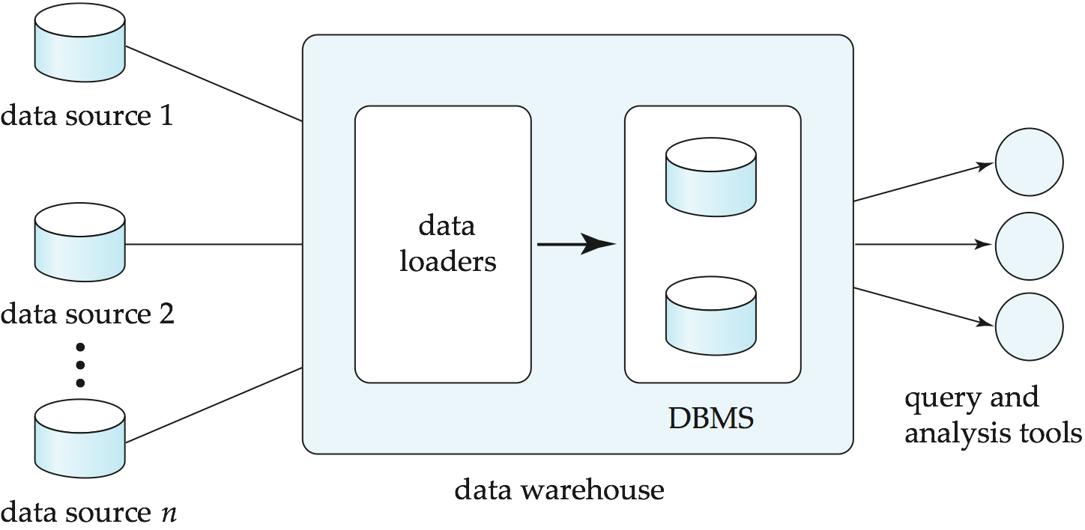
Data Warehousing

Slide 46
Overview (Cont.)
Common steps in data analytics
Gather data from multiple sources into one location
Data warehouses also integrated data into common schema
Data often needs to be extracted from source formats, transformed to common schema, and loaded into the data warehouse
Can be done as ETL (extract-transform-load), or ELT (extract-load-transform)
Generate aggregates and reports summarizing data
Dashboards showing graphical charts/reports
Online analytical processing (OLAP) systems allow interactive querying
Statistical analysis using tools such as R/SAS/SPSS
Including extensions for parallel processing of big data
Build predictive models and use the models for decision making

Slide 47
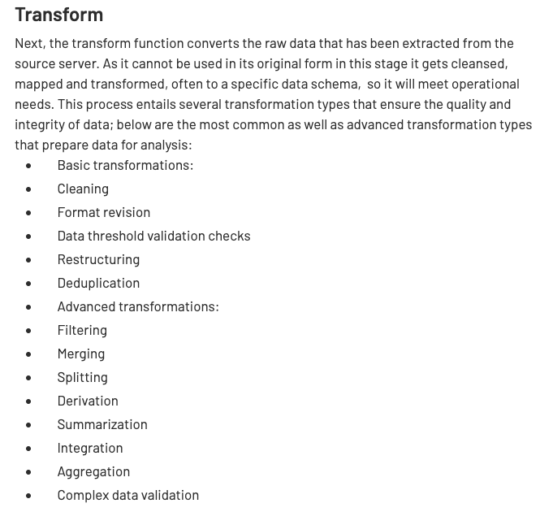
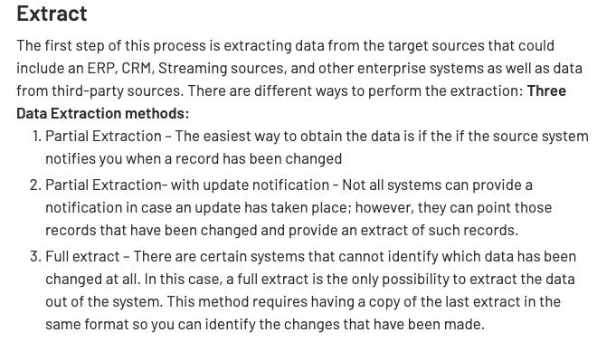
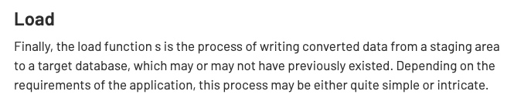
ETL Concepts
https://databricks.com/glossary/extract-transform-load

Slide 48
Star Schema

Slide 49
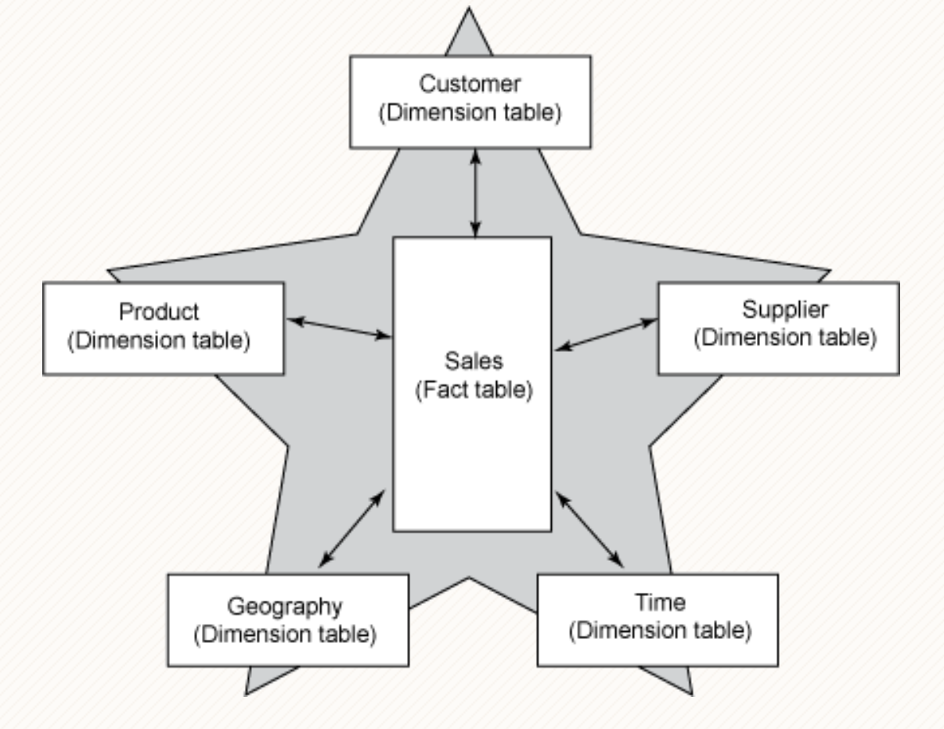
Facts and Dimensions
A common model for (some) data in a date warehouse is a star schema.
There are one or more fact tables that have records for small facts, e.g.
Sold product A.
To customer B.
At price C.
Facts are positioned in dimensions, e.g.
Date, time
Location
Product category
… …
Queries ask for summations and aggregations in dimensions, e.g.
Total sales of products in category X, to customers in country Y during year Z.
Queries can roll-up, drill down, pivot, … …
This is a generalization of the spreadsheet concept of pivot tables.

Slide 50
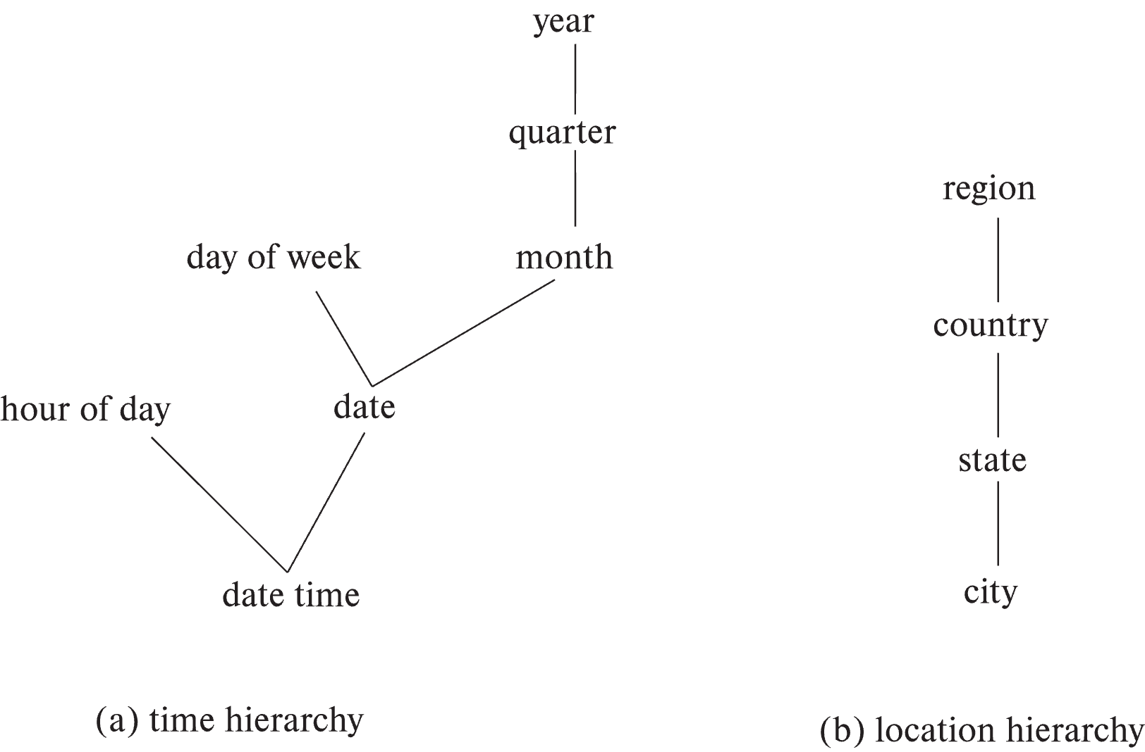
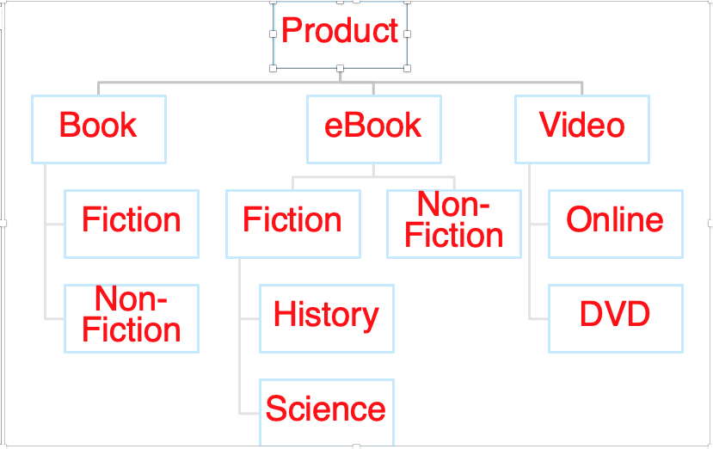
Hierarchies on Dimensions
Hierarchy on dimension attributes: lets dimensions be viewed at different levels of detail
E.g., the dimension datetime can be used to aggregate by hour of day, date, day of week, month, quarter or year
Another dimension could be ... Product category.

Slide 51
Another Dimension Example – Product Categories
Product
Book
eBook
Video
Fiction
Non-Fiction
Non-
Fiction
Fiction
Online
DVD
History
Science

Slide 52
Pivot Table Example
See pivot-table-example.xls in lecture folder.
Stolen from https://www.excel-easy.com/data-analysis/pivot-tables.html

Slide 53
Homework 5/Project
53 | W4111-2025S-11-Module-II-NoSql-Module-IV-1 © Donald F. Ferguson, 2025

Slide 54
Overview

Slide 55
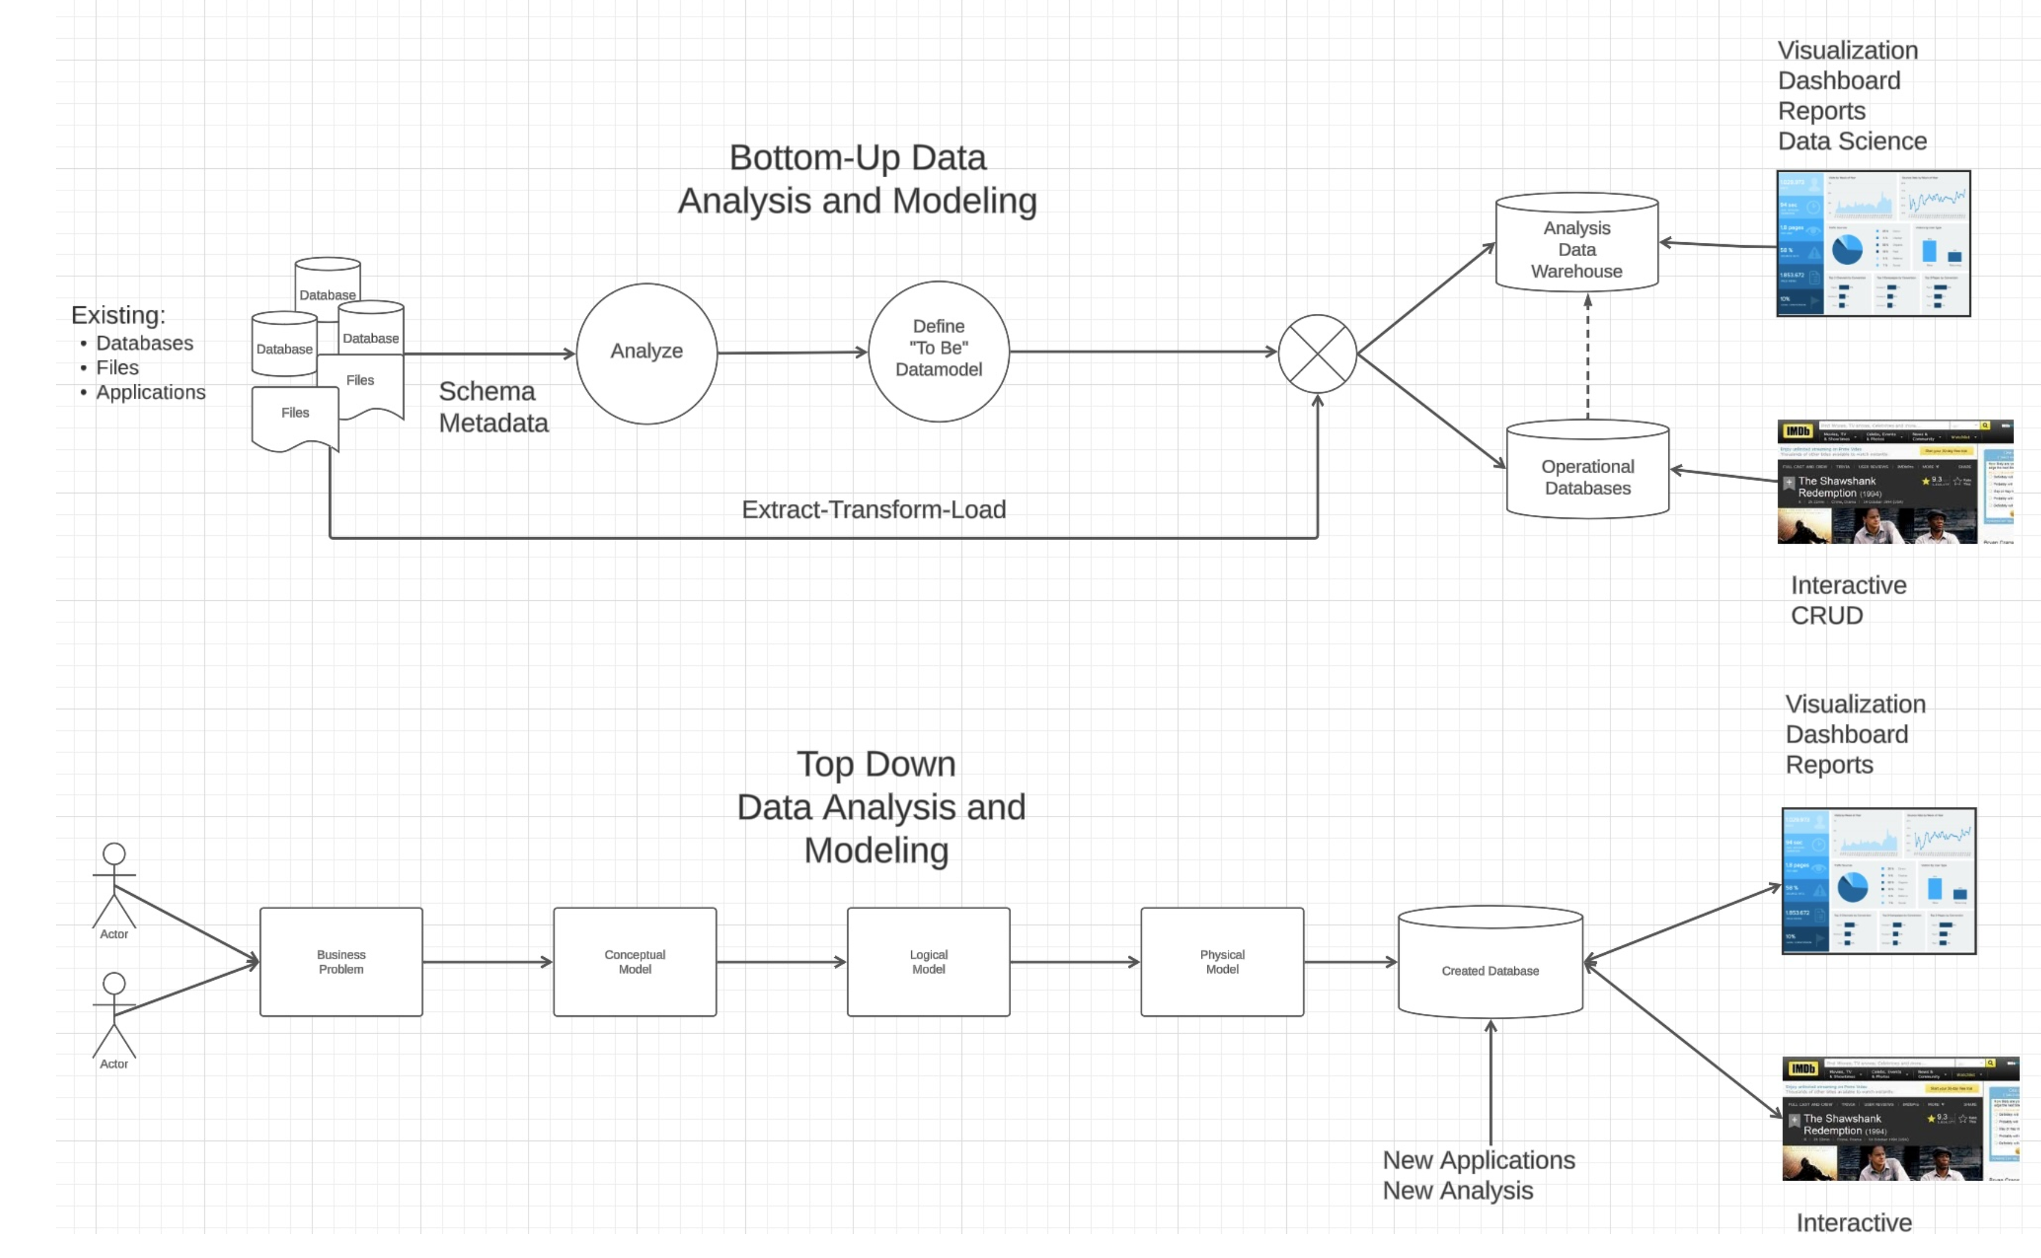
Data Engineering and Applications

Slide 56
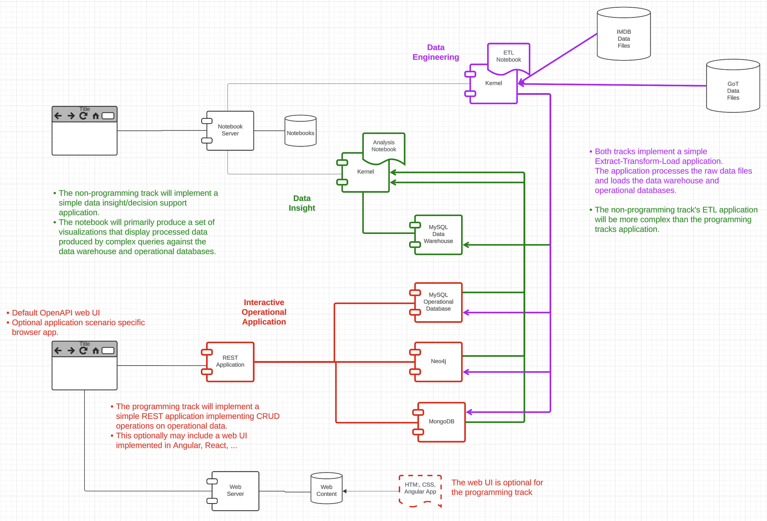
Big Picture

Slide 57
Full Stack Web Application

Slide 58
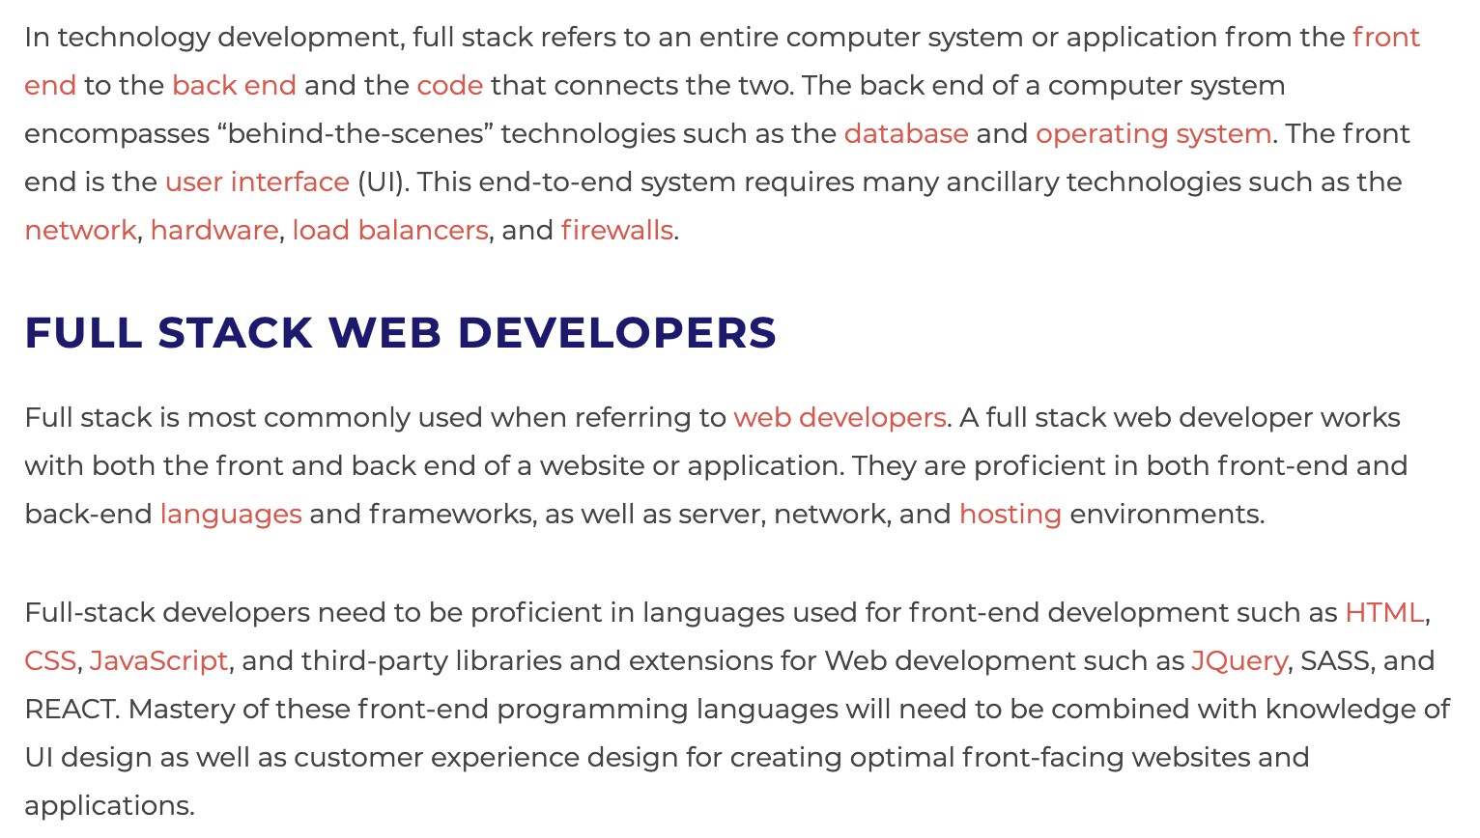
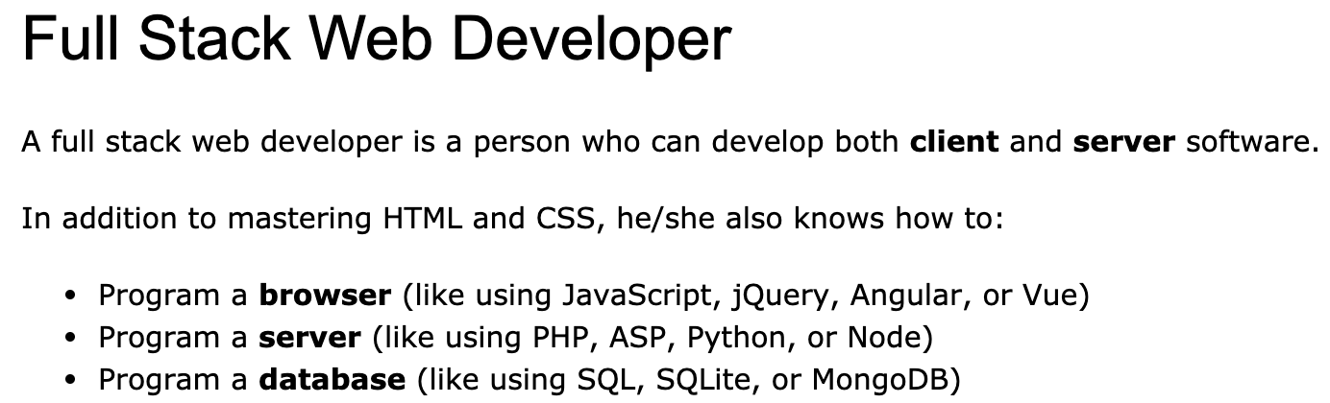
Full Stack Application
https://www.w3schools.com/whatis/whatis_fullstack.asp
There are courses that cover topics:
COMS W4153: Advanced Software Engineering
COMS W4111: Introduction to Databases
COMS W4170 - User Interface Design
This course will focus on cloud realization, microservices and application patterns, ... ...
Also, I am not great at UIs ... ... We will not emphasize or require a lot of UI work.
https://www.webopedia.com/definitions/full-stack/

Slide 59
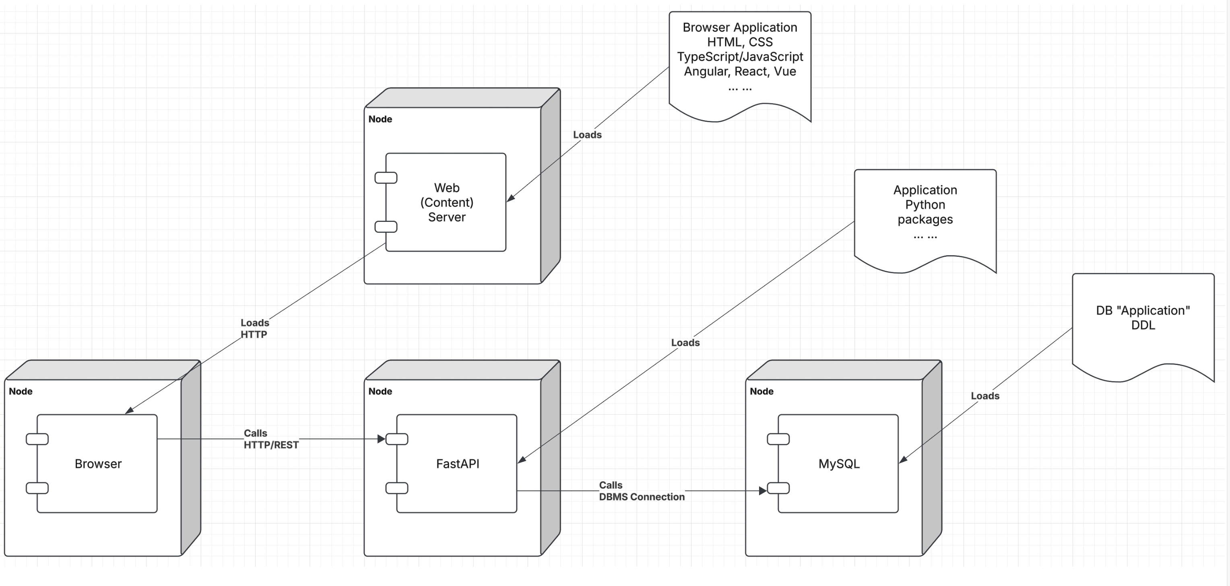
Conceptual Model

Slide 60
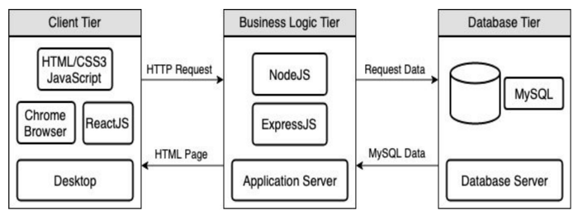
Full Stack Web Application
M = Mongo
E = Express
R = React
N = Node
I start with FastAPI and MySQL, but all the concepts are the same.
https://levelup.gitconnected.com/a-complete-guide-build-a-scalable-3-tier-architecture-with-mern-stack-es6-ca129d7df805
My preferences are to replace React with Angular, and Node with Flask.
There are three projects to design, develop, test, deploy, ... ...
Browser UI application.
Microservice.
Database.
We will initial have two deployments: local machine, virtual machine. We will ignore the database for step 1.

Slide 61
Some Terms
A web application server or web application framework: “A web framework (WF) or web application framework (WAF) is a software framework that is designed to support the development of web applications including web services, web resources, and web APIs. Web frameworks provide a standard way to build and deploy web applications on the World Wide Web. Web frameworks aim to automate the overhead associated with common activities performed in web development. For example, many web frameworks provide libraries for database access, templating frameworks, and session management, and they often promote code reuse.” (https://en.wikipedia.org/wiki/Web_framework)
REST: “REST (Representational State Transfer) is a software architectural style that was created to guide the design and development of the architecture for the World Wide Web. REST defines a set of constraints for how the architecture of a distributed, Internet-scale hypermedia system, such as the Web, should behave. The REST architectural style emphasises uniform interfaces, independent deployment of components, the scalability of interactions between them, and creating a layered architecture to promote caching to reduce user-perceived latency, enforce security, and encapsulate legacy systems.[1] REST has been employed throughout the software industry to create stateless, reliable web-based applications.” (https://en.wikipedia.org/wiki/REST)

Slide 62
Some Terms
OpenAPI: “The OpenAPI Specification, previously known as the Swagger Specification, is a specification for a machine-readable interface definition language for describing, producing, consuming and visualizing web services.” (https://en.wikipedia.org/wiki/OpenAPI_Specification)
Model: “A model represents an entity of our application domain with an associated type.” (https://medium.com/@nicola88/your-first-openapi-document-part-ii-data-model-52ee1d6503e0)
Routers: “What fastapi docs says about routers: If you are building an application or a web API, it’s rarely the case that you can put everything on a single file. FastAPI provides a convenience tool to structure your application while keeping all the flexibility.” (https://medium.com/@rushikeshnaik779/routers-in-fastapi-tutorial-2-adf3e505fdca)
Summary:
These are general concepts, and we will go into more detail in the semester.
FastAPI is a specific technology for Python.
There are many other frameworks applicable to Python, NodeJS/TypeScript, Go, C#, Java, … …
They all surface similar concepts with slightly different names.

Slide 63
REST (https://restfulapi.net/)
What is REST
REST is acronym for REpresentational State Transfer. It is architectural style for distributed hypermedia systems and was first presented by Roy Fielding in 2000 in his famous dissertation.
Like any other architectural style, REST also does have it’s own 6 guiding constraints which must be satisfied if an interface needs to be referred as RESTful. These principles are listed below.
Guiding Principles of REST
Client–server – By separating the user interface concerns from the data storage concerns, we improve the portability of the user interface across multiple platforms and improve scalability by simplifying the server components.
Stateless – Each request from client to server must contain all of the information necessary to understand the request, and cannot take advantage of any stored context on the server. Session state is therefore kept entirely on the client.
Cacheable – Cache constraints require that the data within a response to a request be implicitly or explicitly labeled as cacheable or non-cacheable. If a response is cacheable, then a client cache is given the right to reuse that response data for later, equivalent requests.
Uniform interface – By applying the software engineering principle of generality to the component interface, the overall system architecture is simplified and the visibility of interactions is improved. In order to obtain a uniform interface, multiple architectural constraints are needed to guide the behavior of components. REST is defined by four interface constraints: identification of resources; manipulation of resources through representations; self-descriptive messages; and, hypermedia as the engine of application state.
Layered system – The layered system style allows an architecture to be composed of hierarchical layers by constraining component behavior such that each component cannot “see” beyond the immediate layer with which they are interacting.
Code on demand (optional) – REST allows client functionality to be extended by downloading and executing code in the form of applets or scripts. This simplifies clients by reducing the number of features required to be pre-implemented.

Slide 64
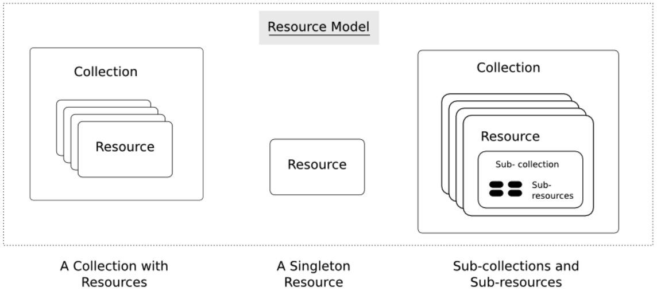
Resources
Resources are an abstraction. The application maps to create things and actions.
“A resource-oriented API is generally modeled as a resource hierarchy, where each node is either a simple resource or a collection resource. For convenience, they are often called a resource and a collection, respectively.
A collection contains a list of resources of the same type. For example, a user has a collection of contacts.
A resource has some state and zero or more sub-resources. Each sub-resource can be either a simple resource or a collection resource.
For example, Gmail API has a collection of users, each user has a collection of messages, a collection of threads, a collection of labels, a profile resource, and several setting resources.
While there is some conceptual alignment between storage systems and REST APIs, a service with a resource-oriented API is not necessarily a database, and has enormous flexibility in how it interprets resources and methods. For example, creating a calendar event (resource) may create additional events for attendees, send email invitations to attendees, reserve conference rooms, and update video conference schedules. (Emphasis added) (https://cloud.google.com/apis/design/resources#resources)
https://restful-api-design.readthedocs.io/en/latest/resources.html

Slide 65
REST – Resource Oriented
When writing applications, we are used to writing functions or methods:
openAccount(last_name, first_name, tax_payer_id)
account.deposit(deposit_amount)
account.close()
We can create and implement whatever functions we need.
REST only allows four methods:
POST: Create a resource
GET: Retrieve a resource
PUT: Update a resource
DELETE: Delete a resource
That’s it. That’s all you get.
A REST client needs no prior knowledge about how to interact with any particular application or server beyond a generic understanding of hypermedia.
“The key characteristic of a resource-oriented API is that it emphasizes resources (data model) over the methods performed on the resources (functionality). A typical resource-oriented API exposes a large number of resources with a small number of methods.” (https://cloud.google.com/apis/design/resources)

Slide 66
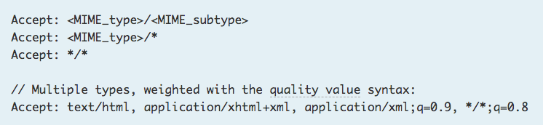
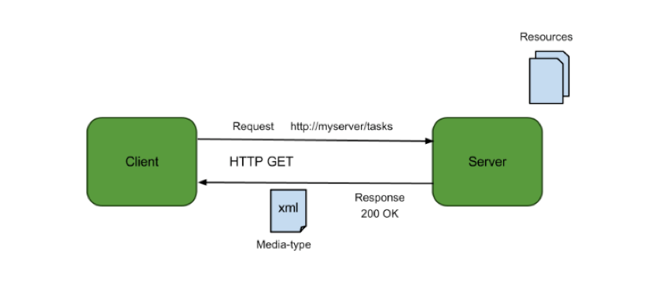
Resources, URLs, Content Types
Relative URL identifies “resource” on the server.
Server implementation maps abstract resource to tangible “thing,” file, DB row, … and any application logic.
Accept type in headers.
Client may be
Browser
Mobile device
Other REST Service
… …
Web media (content) type, e.g.
text/html
application/json

Slide 67
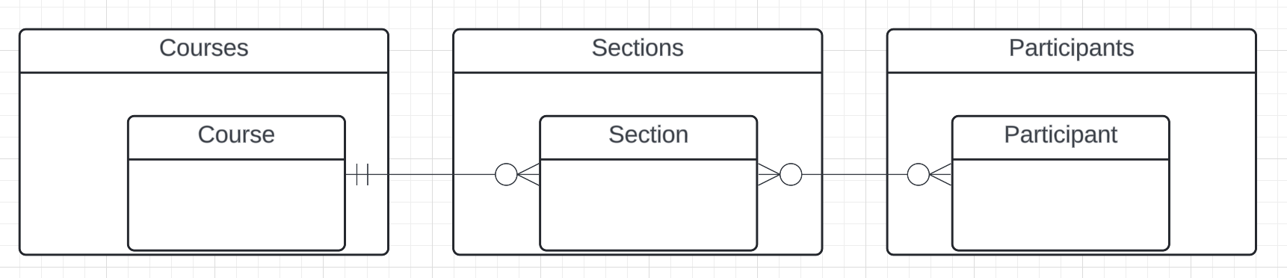
Resources and APIs
Base resources, paths and methods:
/courses: GET, POST
/courses/<id>: GET, PUT, DELETE
/sections: GET, POST
/sections/<id>: GET, PUT, DELETE
/participants: GET, POST
/participants/<id>: GET, PUT, DELETE
There are relative, navigation paths:
/courses/<id>/sections
/participants/<id>/sections
etc.
GET on resources that are collections may also have query parameters.
There are two approaches to defining API
Start with OpenAPI document and produce an implementation template.
Start with annotated code and generate API document.
In either approach, I start with models.
Also,
I lack the security permission to update CourseWorks.
I can choose to not surface the methods or raise and exception.

Slide 68
Data Modeling Concepts and REST
Almost any data model has the same core concepts:
Types and instances:
Entity Type: A definition of a type of thing with properties and relationships.
Entity Instance: A specific instantiation of the Entity Type
Entity Set Instance: An Entity Type that:
Has properties and relationships like any entity, but ...
Has at least one special relationship – contains.
Operations, minimally CRUD, that manipulate entity types and instances:
Create
Retrieve
Update
Delete
Reference/Identify/... ...
Host/database/table/pk

Slide 69
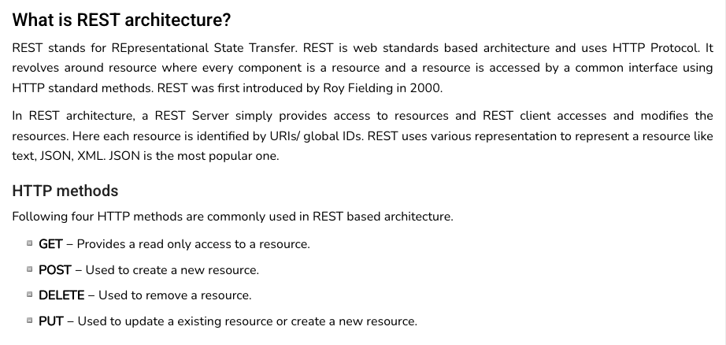
REST (https://www.tutorialspoint.com/restful/restful_introduction.htm)

Slide 70
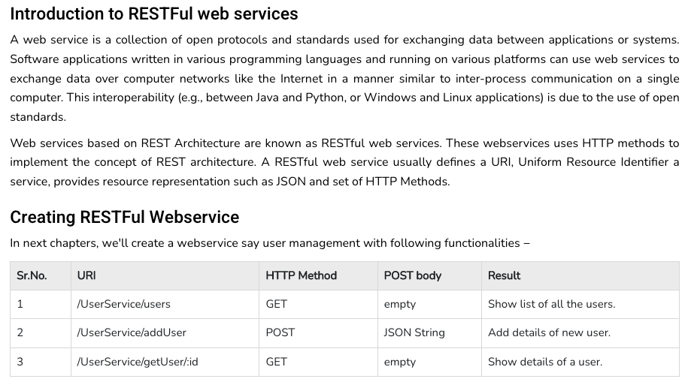
REST (https://www.tutorialspoint.com/restful/restful_introduction.htm)

Slide 71
Some Walkthroughs

Slide 72
Some Walkthroughs
Complex
/Users/donald.ferguson/Dropbox/000/000-A-Current-Examples/W4111-FastAPI-IMDB-Solution
/Users/donald.ferguson/Dropbox/000/000-A-Current-Examples/current-dashboard
Project template
Web application
Some non-programming examples

Slide 73
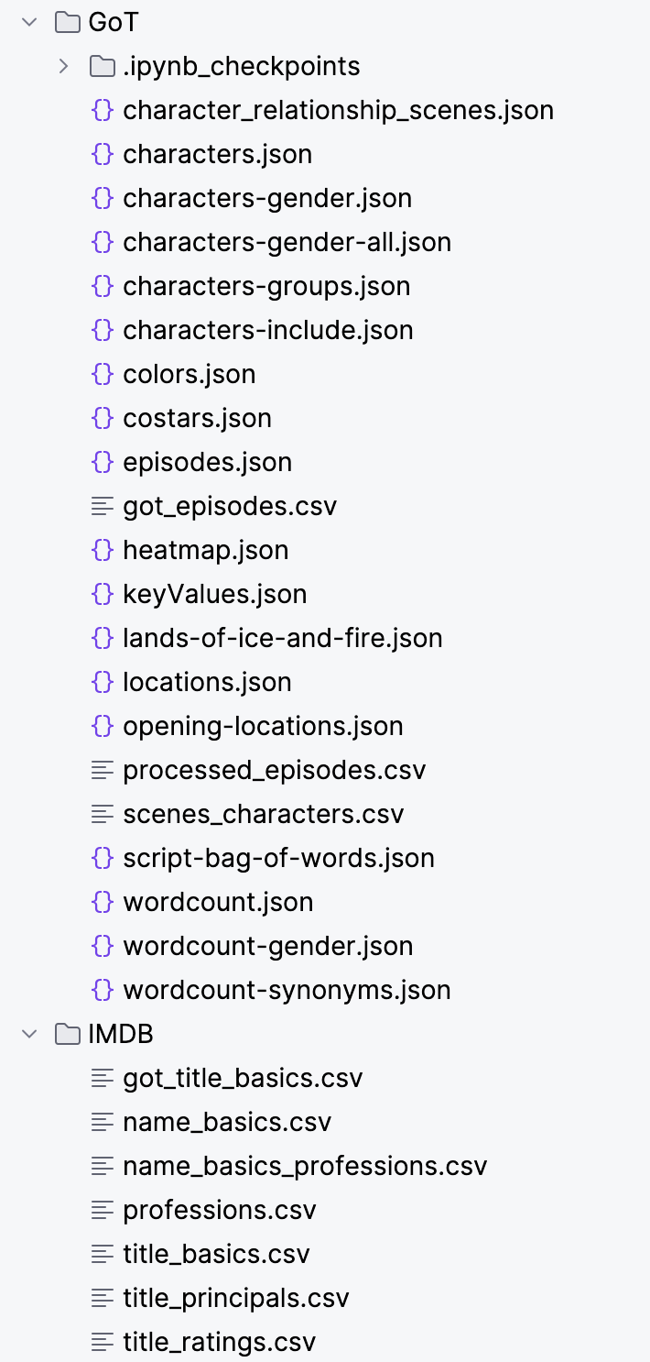
The Data
With a little bit of tinkering, I come up with the following entity types/entity sets
name_basics
professions
genres
title_basics
title_ratings
seasons → episodes → scenes
Characters
And a lot of relationships

Slide 74
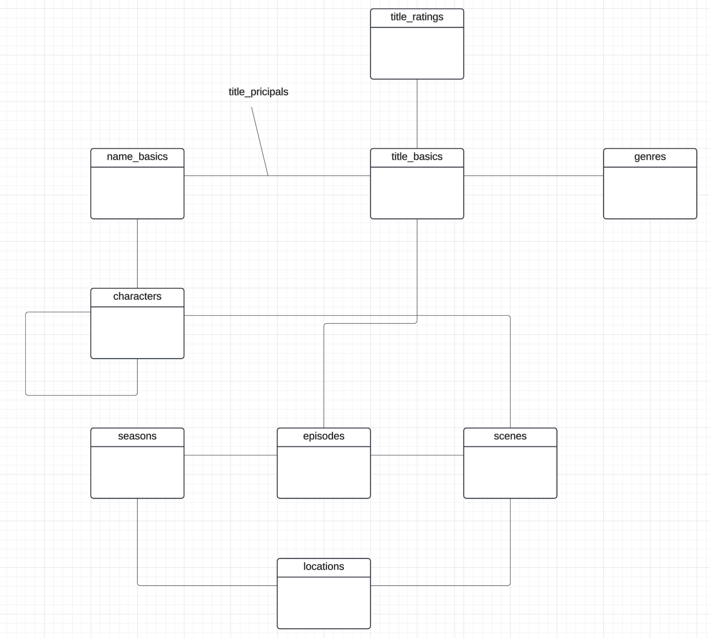
Conceptual Model
Core relational holds
name_basics
title_basics
title_ratings
characters
MongoDB holds
season_episode_scene
characters
Neo4j holds characters and their relationships
Data Warehouse holds wide-flat processed extracts of data.

Slide 75
Let’s Look at the Programming Project

Slide 76
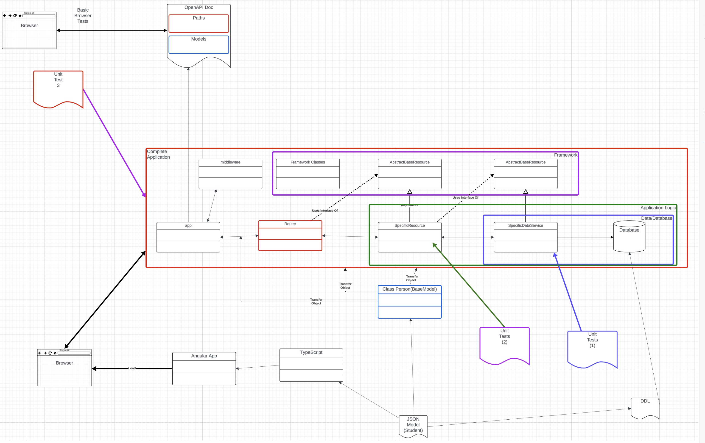
Let’s Look at the Programming Project

Slide 77
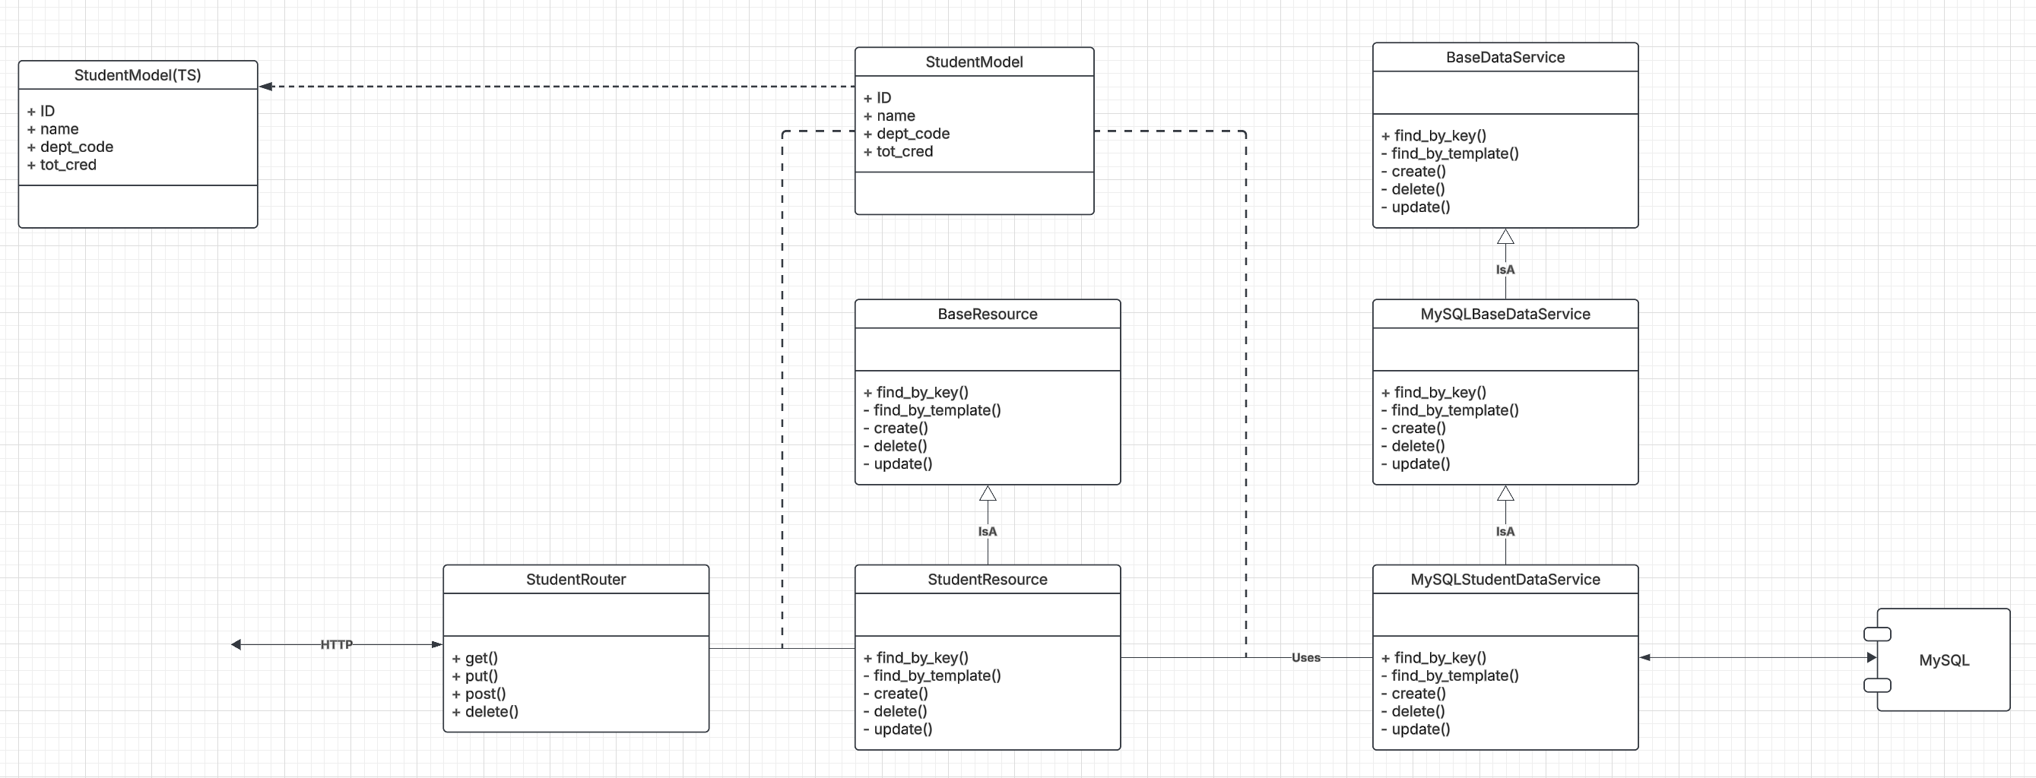
Let’s Look at the Programming Project

